Slide 1
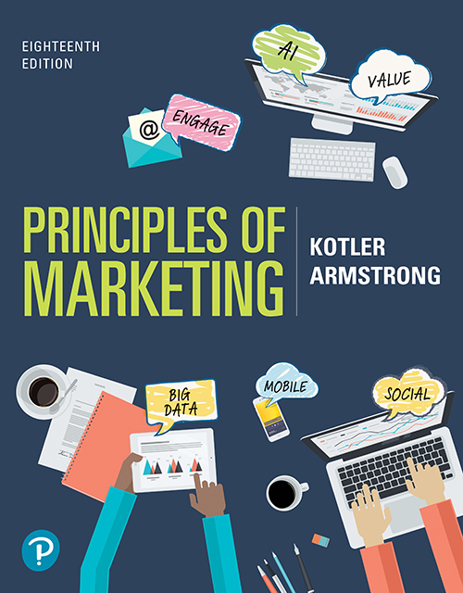
Principles of Marketing
Eighteenth Edition
Chapter 11
Pricing Strategies: Additional Considerations
Copyright © 2021, 2018, 2016 Pearson Education, Inc.
Notes:
If this PowerPoint presentation contains mathematical equations, you may need to check that your computer has the following installed:
1) Math Type Plugin
2) Math Player (free versions available)
3) NVDA Reader (free versions available)

Slide 2
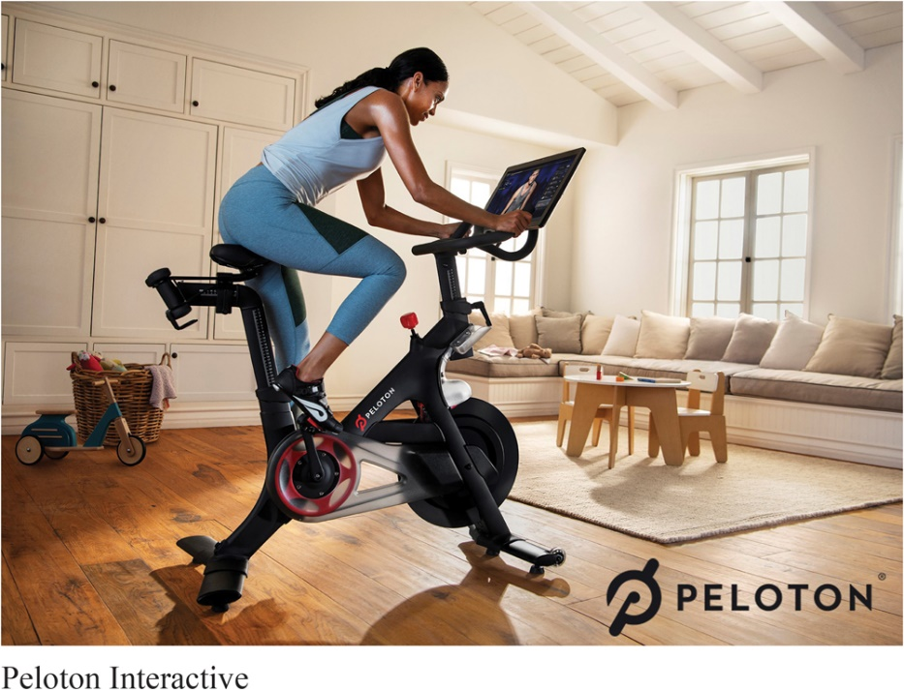
PELOTON: Premium Priced. But It’s Not about the Price
For the Peloton faithful, it isn’t just about the price of a Peloton bike. It’s about the values received from membership in the dynamic, closely connected Peloton community.
Notes:
Peloton sells its in-home stationary bikes at a substantial price premium over the competition. Yet, it has attracted a large and growing cult following of users who like the value they get for the price they pay.

Slide 3
Learning Objectives
11.1 Describe the major strategies for pricing new products.
11.2 Explain how companies find a set of prices that maximizes the profits from the total product mix.
11.3 Discuss how companies adjust their prices to take into account different types of customers and situations.
11.4 Discuss the key issues related to initiating and responding to price changes.
11.5 Discuss the major public policy concerns and key pieces of legislation that affect pricing decisions.

Slide 4
Learning Objective 1
Describe the major strategies for pricing new products.
Notes:
Discussion Question
Compare and contrast market-skimming and market-penetration pricing strategies and discuss the conditions under which each is appropriate. For each strategy, give
an example of a recently introduced product that used that pricing strategy.
Learning Objective 1 Summary
Pricing is a dynamic process, and pricing strategies usually change as the product passes through its life cycle. The introductory stage—setting prices for the first time—is especially challenging. The company can decide on one of several strategies for pricing innovative new products. It can use market-skimming pricing by initially setting high prices to “skim” the maximum amount of revenue from various segments of the market. Or it can use market-penetrating pricing by setting a low initial price to penetrate the market deeply and win a large market share. Several conditions must be set for either new product pricing strategy to work.

Slide 5
New Pricing Strategies (1 of 2)
Market-skimming pricing strategy sets high initial prices to “skim” revenue layers from the market.
Product quality and image must support the price.
Buyers must want the product at the price.
Notes:
Pricing strategies usually change as the product passes through its life cycle. The introductory stage is especially challenging. Companies bringing out a new product face the challenge of setting prices for the first time. They can choose between two broad strategies: market-skimming pricing and market-penetration pricing.
Apple frequently uses market-skimming pricing (or price skimming). When Apple first introduced the iPhone, its initial price was as high as $599 per phone. The phones were purchased only by customers who really wanted the sleek new gadget and could afford to pay a high price for it. Six months later, Apple dropped the price to $399 for an 8-GB model and $499 for the 16-GB model to attract new buyers. Within a year, it dropped prices again to $199 and $299, respectively, and you can now get a basic 8-GB model for free with a wireless phone contract. In this way, Apple has skimmed the maximum amount of revenue from the various segments of the market.
Market skimming makes sense only under certain conditions. First, the product’s quality and image must support its higher price, and enough buyers must want the product at that price. Second, the costs of producing a smaller volume cannot be so high that they cancel the advantage of charging more. Finally, competitors should not be able to enter the market easily and undercut the high price.

Slide 6
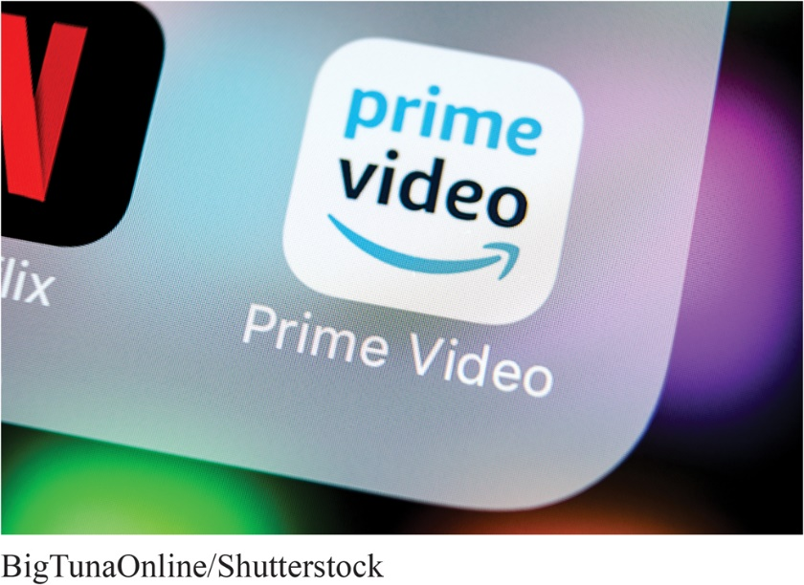
New Pricing Strategies (2 of 2)
Market-penetration pricing involves setting a low price for a new product in order to attract a large number of buyers and a large market share.
Penetration pricing: Amazon used penetration pricing for Amazon Prime Video in more than 240 international markets to build a customer base and make headway against higher priced Netflix.
Notes:
Rather than setting a high initial price to skim off small but profitable market segments, some companies use market-penetration pricing.
The high sales volume results in falling costs, allowing companies to cut their prices even further.

Slide 7
Learning Objective 2
Explain how companies find a set of prices that maximizes the profits from the total product mix.
Notes:
Discussion Question
Define captive-product pricing and give examples. What must marketers be concerned about when implementing this type of pricing?
Learning Objective 2 Summary
When the product is part of a product mix, the firm searches for a set of prices that will maximize the profits from the total mix. In product line pricing, the company determines the price steps for the entire product line it offers. In addition, the company must set prices for optional products (optional or accessory products included with the main product), captive products (products that are required for using the main product), and by-products (waste or residual products produced when making the main product).

Slide 8
Product Mix Pricing Strategies
Product line pricing
Optional product pricing
Captive product pricing
By-product pricing
Product bundle pricing
Notes:
The strategy for setting a product’s price often has to be changed when the product is part of a product mix. In this case, the firm looks for a set of prices that maximizes its profits on the total product mix. Pricing is difficult because the various products have related demands and costs and face different degrees of competition.

Slide 9
Product Mix Pricing Strategies (1 of 3)
Product Line and Optional Product Pricing
Product line pricing takes into account the cost differences between products in the line, customer evaluations of their features, and competitors’ prices.
Optional product pricing takes into account optional or accessory products along with the main product.
Notes:
Product Line Pricing
Companies usually develop product lines rather than single products. In product line pricing, management must determine the price steps to set between the various products in a line. The product line could include a broad range of prices for the various products.
Optional Product Pricing
Pricing options is a sticky problem. Companies must decide which items to include in the base price and which to offer as options.

Slide 10

Product Mix Pricing Strategies (2 of 3)
Captive product pricing sets prices of products that must be used along with the main product.
Captive-product pricing: Nintendo makes little or no profit on its Switch video game console but makes up for it through sales of higher-margin video games.
Notes:
Captive product pricing: Examples of captive products are razor blade cartridges, video games, printer cartridges, and e-books. Producers of the main products often price them low and set high markups on the supplies. For example, Amazon introduced its Kindle Fire tablet for as low as $199, a loss of an estimated $10 per machine. It hoped to more than make up for the loss through sales of digital books, music, and movies to be viewed on the devices.
However, companies that use captive product pricing must be careful. Finding the right balance between the main product and captive product prices can be tricky. Even more, consumers trapped into buying expensive captive products may come to resent the brand that ensnared them.
In the case of services, captive product pricing is called two-part pricing. The price of the service is broken into a fixed fee plus a variable usage rate. Thus, at Six Flags and other amusement parks, you pay a daily ticket or season pass charge plus additional fees for food and other in-park features.

Slide 11
Product Mix Pricing Strategies (3 of 3)
Product Line and Optional Product Pricing
By-product pricing sets a price for by-products in order to make the main product’s price more competitive.
Product bundle pricing combines several products at a reduced price.
Notes:
Producing products and services often generates by-products. If the by-products have no value and if getting rid of them is costly, this will affect pricing of the main product. Using by-product pricing, the company seeks a market for these by-products to help offset the costs of disposing of them and help make the price of the main product more competitive. The by-products themselves can even turn out to be profitable—turning trash into cash.
Using product bundle pricing, sellers often combine several products and offer the bundle at a reduced price. For example, fast-food restaurants bundle a burger, fries, and a soft drink at a “combo” price. And Comcast, Time Warner, Verizon, and other telecommunications companies bundle TV service, phone service, and high-speed internet connections at a low combined price. Price bundling can promote the sales of products consumers might not otherwise buy, but the combined price must be low enough to get them to buy the bundle.

Slide 12
Learning Objective 3
Discuss how companies adjust their prices to take into account different types of customers and situations.
Notes:
Discussion Questions
What is dynamic pricing? Why is it especially prevalent online? Is it legal?
Learning Objective 3 Summary
Companies apply a variety of price adjustment strategies to account for differences in consumer segments and situations. One is discount and allowance pricing, whereby the company establishes cash, quantity, functional, or seasonal discounts, or varying types of allowances. A second strategy is segmented pricing, where the company sells a product at two or more prices to accommodate different customers, product forms, locations, or times. Sometimes companies consider more than economics in their pricing decisions, using psychological pricing to better communicate a product’s intended position. In promotional pricing, a company offers discounts or temporarily sells a product below list price as a special event, sometimes even selling below cost as a loss leader. Another approach is geographical pricing, whereby the company decides how to price to distant customers, choosing from such alternatives as FOB-origin pricing, uniform-delivered pricing, zone pricing, basing-point pricing, and freight-absorption pricing. Using dynamic pricing, a company can adjust prices continually to meet the characteristics and needs of individual customers and situations. Finally, international pricing means that the company adjusts its price to meet different conditions and expectations in different world markets.

Slide 13
Price Adjustment Strategies
Table 11.2 Price Adjustments
Strategy | Description
Discount and allowance pricing | Reducing prices to reward customer responses such as volume purchases, paying early, or promoting the product
Segmented pricing | Adjusting prices to allow for differences in customers, products, or locations
Psychological pricing | Adjusting prices for psychological effect
Promotional pricing | Temporarily reducing prices to spur short-run sales
Geographical pricing | Adjusting prices to account for the geographic location of customers
Dynamic and personalized pricing | Adjusting prices continually to meet the characteristics and needs of individual customers and situations
International pricing | Adjusting prices for international markets
Notes:
Companies usually adjust their basic prices to account for various customer differences and changing situations. Here, we examine the seven price adjustment strategies summarized in Table 11.2: discount and allowance pricing, segmented pricing, psychological pricing, promotional pricing, geographical pricing, dynamic pricing, and international pricing.

Slide 14
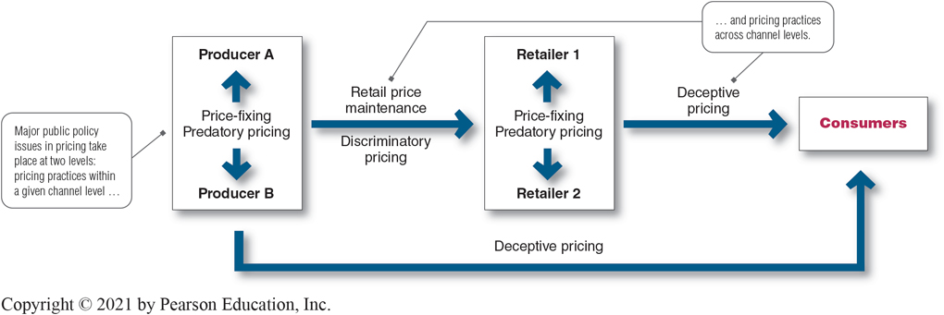
Figure 11.2 Public Policy Issues in Pricing
Source: Adapted from Dhruv Grewal and Larry D. Compeau, “Pricing and Public Policy: A Research Agenda and Overview of the Special Issue,” Journal of Public Policy and Marketing, Spring 1999, pp. 3–10.
Notes:
Long Description
The flowchart shows the following information:
Has competitor cut price?
If yes, will lower price negatively affect our market share and profits?
If yes, Can or should effective action be taken?
If no to the above three questions, hold current price; continue to monitor competitor’s price.
If yes to the final third question, reduce price, raise perceived value, improve quality and increase price, and launch low-price “fighter brand.”
When a competitor cuts prices, a company’s first reaction may be to drop its prices as well. But that is often the wrong response. Instead, the firm may want to emphasize the “value” side of the price–value equation.

Slide 15
Price Adjustment Strategies (1 of 12)
Discount pricing reduces prices on purchases during a stated period of time or of larger quantities.
Allowances discount list prices by providing promotional money in return for an agreement to feature the manufacturer’s products in some way. Allowances include trade-in allowances and promotional allowances.
Notes:
Discounts include cash discounts for paying promptly, quantity discounts for buying in large volume, or functional (trade) discounts for selling, storing, distribution, and record keeping.
Allowances include trade-in allowances for turning in old items when buying new ones and promotional allowances to reward dealers for participating in advertising or sales support programs.

Slide 16
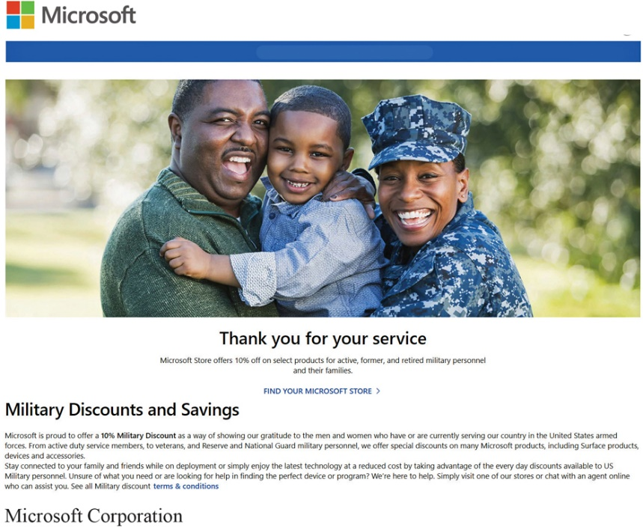
Price Adjustment Strategies (2 of 12)
Segmented pricing involves selling a product or service at two or more prices, where the difference in prices is not based on differences in costs.
Customer-segment pricing: Microsoft and other electronics brands have launched dedicated online stores for military members, veterans, and their families, with discounts of 10 percent or more on the wide range of products offered there.
Notes:
Product-form pricing: A roomier business class seat on a flight from New York to London is many times the price of an economy seat on the same flight. To customers who can afford it, the extra comfort and service are worth the extra charge.
In segmented pricing companies will often adjust their basic prices to allow for differences in customers, products, and locations.
Long Description
The text below the photo reads "Thank you for your service; Microsoft Store offers 10 percent off on select products for active, former, and retired military personnel and their families." It is followed by a link option that reads "Find your Microsoft Store." The link is in turn followed by the text that reads "Military Discounts and Savings. Microsoft is proud to offer a 10 percent Military Discount as a way of showing our gratitude to the men and women who have or are currently serving our country in the United States armed forces. From active duty service members, to veterans, and Reserve and National Guard military personnel, we offer special discounts on many Microsoft products, including Surface products, devices and accessories. Stay connected to your family and friends while on deployment or simply enjoy the latest technology at a reduced cost by taking advantage of the everyday discounts available to US Military personnel. Unsure of what you need or are looking for help in finding the perfect device or program? We're here to help. Simply visit one of our stores or chat with an agent online who can assist you. See all Military discount terms and conditions."

Slide 17
Price Adjustment Strategies (3 of 12)
Segmented Pricing
Customer-segment pricing
Product form pricing
Location-based pricing
Time-based pricing
Notes:
Segmented pricing takes several forms.
Under customer-segment pricing, different customers pay different prices for the same product or service. Museums and movie theaters, for example, may charge a lower admission for students and senior citizens.
Under product form pricing, different versions of the product are priced differently but not according to differences in their costs.
Using location-based pricing, a company charges different prices for different locations, even though the cost of offering each location is the same. For instance, state universities charge higher tuition for out-of-state students, and theaters vary their seat prices because of audience preferences for certain locations.
Finally, using time-based pricing, a firm varies its price by the season, the month, the day, and even the hour. For example, movie theaters charge matinee pricing during the daytime, and resorts give weekend and seasonal discounts.

Slide 18
Price Adjustment Strategies (4 of 12)
Segmented Pricing
For segmented pricing to be effective:
Market must be segmentable
Segments must show different degrees of demand
Costs of segmenting cannot exceed the extra revenue
Must be legal
Notes:
Discussion Question
How have you benefited from price segmentation?
Most likely they have had student discounts. Ask them why that is effective given the criteria above.
It is most important that segmented prices reflect real differences in customers’ perceived value. Consumers in higher price tiers must feel that they’re getting their extra money’s worth for the higher prices paid. By the same token, companies must be careful not to treat customers in lower price tiers as second-class citizens. Otherwise, in the long run, the practice will lead to customer resentment and ill will.
For example, in recent years, the airlines have incurred the wrath of frustrated customers at both ends of the airplane. Passengers paying full fare for business- or first-class seats often feel that they are being gouged. At the same time, passengers in lower-priced coach seats feel that they’re being ignored or treated poorly.

Slide 19
Price Adjustment Strategies (5 of 12)
Psychological Pricing
Psychological pricing considers the psychology of prices and not simply the economics; the price is used to say something about the product.
Reference prices are prices that buyers carry in their minds and refer to when they look at a given product.
Notes:
Discussion Question
How well do you carry prices of coffee, pizza, and milk in your head?
It might be interesting to collect the prices of items sold near or on campus including coffee, pizza, and sandwiches. Ask students how well they know these prices, have them write down the price of these items, and then check themselves. You will often find that people do NOT know prices as well as they think they do.
With psychological pricing, consumers usually perceive higher-priced products as having higher quality. Who’s the better lawyer, one who charges $50 per hour or one who charges $500 per hour?
Another aspect of psychological pricing is reference prices which might be formed by noting current prices, remembering past prices, or assessing the buying situation. Sellers can influence or use these consumers’ reference prices when setting price. For example a grocery retailer might place its store brand next to a more expensive branded item or offer more expensive models that don’t sell very well to make its less expensive but still high-priced models look more affordable by comparison.
Even small differences in price can signal product differences. A 9 or 0.99 at the end of a price often signals a bargain. High-end retailers might favor prices ending in a whole number and others use 00-cent endings on regularly priced items and 99-cent endings on discount merchandise.

Slide 20
Price Adjustment Strategies (6 of 12)
Promotional Pricing
Promotional pricing is characterized by temporarily pricing products below the list price, and sometimes even below cost, to increase short-run sales. Examples include:
special-event pricing
limited-time offers
cash rebates
low-interest financing, extended warranties, or free maintenance
Notes:
Promotional pricing can take many different forms and be employed by manufacturers, wholesalers, or retailers. The main objective of promotional pricing is to move prospective customers over humps that are holding them back from making the purchase decision. This pricing tactic should be used with caution as it can have adverse affects such as price wars or damage to brand equity.

Slide 21
Price Adjustment Strategies (7 of 12)
Geographical pricing is used for customers in different parts of the country or the world.
FOB-origin pricing
Uniform-delivered pricing
Zone pricing
Basing-point pricing
Freight-absorption pricing
Notes:
Geographical Pricing
A company also must decide how to price its products for customers located in different parts of the United States or the world. Should the company risk losing the business of more-distant customers by charging them higher prices to cover the higher shipping costs?

Slide 22
Price Adjustment Strategies (8 of 12)
Geographical Pricing
FOB-origin (free on board) pricing is a geographical pricing strategy in which goods are placed free on board a carrier; the customer pays the freight from the factory to the destination.
Uniform-delivered pricing is a geographical pricing strategy in which the company charges the same price plus freight to all customers, regardless of their location.
Notes:
Since a customer picks up its own cost, supporters of FOB-origin pricing feel that this is the fairest way to assess freight charges. The disadvantage, however, is that the company will be a high-cost firm to distant customers.
Uniform-delivered pricing is the opposite of FOB pricing. Here, the company charges the same price plus freight to all customers, regardless of their location. The freight charge is set at the average freight cost.

Slide 23
Price Adjustment Strategies (9 of 12)
Geographical Pricing
Zone pricing is a strategy in which the company sets up two or more zones where customers within a given zone pay the same price.
Basing-point pricing means that a seller selects a given city as a “basing point” and charges all customers the freight cost from that city to the customer.
Notes:
Zone pricing falls between FOB-origin pricing and uniform-delivered pricing. The more distant the zone, the higher the price. In this way, the customers within a given price zone receive no price advantage from the company. For example, customers in Atlanta and Boston may pay the same total price even if the actual freight cost for Atlanta is significantly less than Boston. One complaint about this strategy is that the Atlanta customer is paying part of the Boston customer’s freight cost.
Using basing-point pricing, a company may set Chicago as the basing point and charge all customers the freight cost from Chicago to the customer’s location. This means that an Atlanta customer pays the freight cost from Chicago to Atlanta, even though the goods may be shipped from Atlanta. If all sellers used the same basing-point city, delivered prices would be the same for all customers, and price competition would be eliminated.

Slide 24
Price Adjustment Strategies (10 of 12)
Geographical Pricing
Freight-absorption pricing is a strategy in which the seller absorbs all or part of the freight charges in order to get the desired business.
Notes:
The seller who is anxious to do business with a certain customer or geographical area might use freight-absorption pricing. The seller might reason that if it can get more business, its average costs will decrease and more than compensate for its extra freight cost. Freight-absorption pricing is used for market penetration and to hold on to increasingly competitive markets.

Slide 25

Price Adjustment Strategies (11 of 12)
Dynamic pricing involves adjusting prices continually to meet the characteristics and needs of individual customers and situations.
Dynamic online pricing benefits both sellers and buyers. Consumers armed with instant access to product and price comparisons can often negotiate better in-store prices.
Notes:
Dynamic pricing: Kohl’s and many other retailers are now using digital price tags that allow them to quickly adjust prices on individual items based on competitive and other market requirements.
Today, most companies use fixed price policies—setting one price for all buyers. However, some companies are now reversing the fixed pricing trend and are now using dynamic pricing.
Dynamic pricing is especially prevalent online. Services ranging from airlines and hotels to sports teams change prices on the fly according to changes in demand or costs, adjusting what they charge for specific items on a day-by-day or even hour-by-hour basis.
Also thanks to the internet, consumers can get instant product and price comparisons from thousands of vendors at price comparison sites and armed with this information, consumers can often negotiate better in-store prices.
In fact, many retailers are finding that ready online access to comparison prices is giving consumers too much of an edge. Store retailers are now devising dynamic pricing strategies to combat the consumer practice of showrooming, comparing prices online while in the store, and then buying the item online at a lower price.

Slide 26
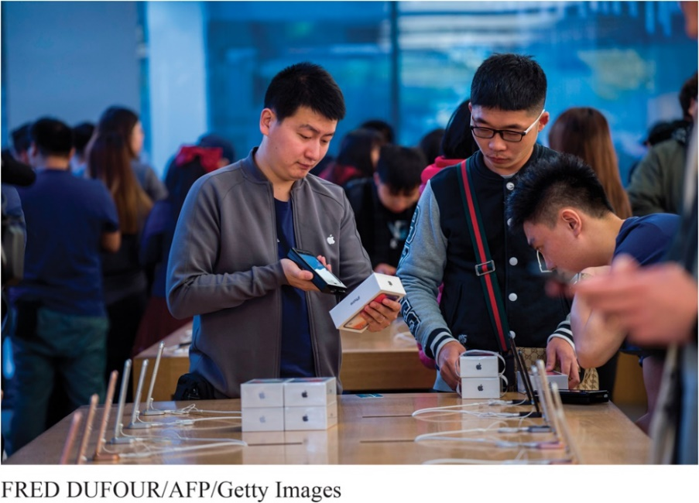
Price Adjustment Strategies (12 of 12)
International pricing involves adjusting prices continually to meet the characteristics and needs of individual customers and situations.
International prices: Companies often must change their pricing strategies from country to country. For example, Apple sells its latest phones at premium prices to affluent Chinese customers but is under pressure to target China’s mid-range customers with lower-priced phones.
Notes:
Companies that market their products internationally must decide what prices to charge in different countries. In some cases, a company can set a uniform worldwide price. However, most companies adjust their prices to reflect local market conditions and cost considerations.

Slide 27
Learning Objective 4
Discuss the key issues related to initiating and responding to price changes.
Notes:
Discussion Question
Should a company always respond to a competitor’s price cut, and what options are available if it does decide to respond?
Learning Objective 4 Summary
When a firm considers initiating a price change, it must consider customers’ and competitors’ reactions. There are different implications to initiating price cuts and initiating price increases. Buyer reactions to price changes are influenced by the meaning customers see in the price change. Competitors’ reactions flow from a set reaction policy or a fresh analysis of each situation.
There are also many factors to consider in responding to a competitor’s price changes. The company that faces a price change initiated by a competitor must try to understand the competitor’s intent as well as the likely duration and impact of the change. If a swift reaction is desirable, the firm should preplan its reactions to different possible price actions by competitors. When facing a competitor’s price change, the company might sit tight, reduce its own price, raise perceived quality, improve quality and raise price, or launch a fighter brand.

Slide 28
Price Changes (1 of 5)
Initiating Price Changes
Price cuts occur due to:
Excess capacity
Increased market share
Price increases occur due to:
Cost inflation
Increased demand
Lack of supply
Notes:
Initiating Price Cuts
Several situations may lead a firm to consider cutting prices. One such circumstance is excess capacity. Another is falling demand in the face of strong price competition or a weakened economy. In such cases, the firm may aggressively cut prices to boost sales and market share. Cutting prices in an industry loaded with excess capacity may lead to price wars as competitors try to hold on to market share.
A company may also cut prices in a drive to dominate the market through lower costs. Either the company starts with lower costs than its competitors, or it cuts prices in the hope of gaining market share that will further cut costs through larger volume. For example, computer and electronics maker Lenovo uses an aggressive low-cost, low-price strategy to increase its share of the PC market in developing countries.
Initiating Price Increases
A successful price increase can greatly improve profits. For example, if the company’s profit margin is 3 percent of sales, a 1 percent price increase will boost profits by 33 percent, if sales volume is unaffected. When a company cannot supply all that its customers need, it may raise its prices, ration products to customers, or both—consider today’s worldwide oil and gas industry.
When raising prices, the company must avoid being perceived as a price gouger. Customers have long memories, and they will eventually turn away from companies or even whole industries that they perceive as charging excessive prices. In the extreme, claims of price gouging may even bring about increased government regulation.
There are some techniques for avoiding these problems. One is to maintain a sense of fairness surrounding any price increase. Price increases should be supported by company communications telling customers why prices are being raised.
Wherever possible, the company should consider ways to meet higher costs or demand without raising prices, such as by:
using more cost-effective ways to produce or distribute its products.
“unbundling” its market offering and price elements separately.
shrinking the product or substituting less-expensive ingredients.

Slide 29
Price Changes (2 of 5)
Buyer Reactions to Pricing Changes
Price increases
Product is “hot”
Company greed
Price cuts
New models will be available
Models are not selling well
Quality issues
Notes:
Customers do not always interpret price changes in a straightforward way. A price increase may have positive meanings for some buyers while others may think the company is simply being greedy by charging what the traffic will bear.
Similarly, consumers may view a price cut as getting a better deal on an exclusive product. Or price cuts may be associated with reductions in quality or the brand’s image being tarnished.

Slide 30
Price Changes (3 of 5)
Competitor Reactions to Pricing Changes
Why did the competitor change the price?
Is the price cut permanent or temporary?
Is the company trying to grab market share?
Is the company doing poorly and trying to increase sales?
Is it a signal to decrease industry prices to stimulate demand?
Notes:
A firm considering a price change must worry about the reactions of its competitors as well as those of its customers. Competitors are most likely to react when the number of firms involved is small, when the product is uniform, and when the buyers are well informed about products and prices. How can the firm anticipate the likely reactions of its competitors?
The problem is complex because, like the customer, the competitor can interpret a company price cut in many ways. The company must guess each competitor’s likely reaction. Figure 11.1 on the next slide explores this issue further.

Slide 31
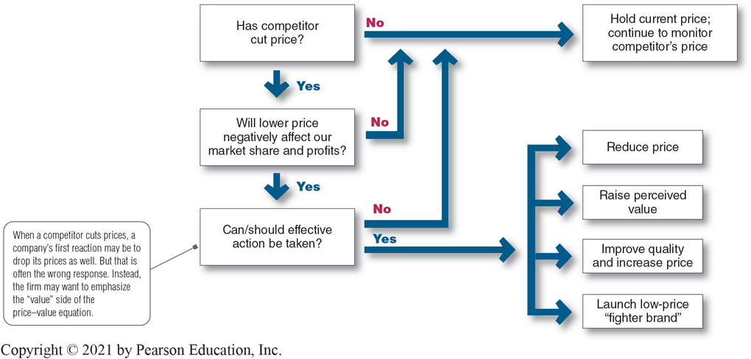
Price Changes (4 of 5)
Figure 11.1 Responding to Competitor Price Changes
Notes:
Figure 11.1 shows the ways a company might assess and respond to a competitor’s price cut. Suppose the company learns that a competitor has cut its price and decides that this price cut is likely to harm its sales and profits. It might simply decide to hold its current price and profit margin. The company might believe that it will not lose too much market share, or that it would lose too much profit if it reduced its own price. Or it might decide that it should wait and respond when it has more information on the effects of the competitor’s price change. However, waiting too long to act might let the competitor get stronger and more confident as its sales increase.
Long Description
The flowchart shows the following information:
Has competitor cut price?
If yes, will lower price negatively affect our market share and profits?
If yes, Can or should effective action be taken?
If no to the above three questions, hold current price; continue to monitor competitor’s price.
If yes to the final third question, reduce price, raise perceived value, improve quality and increase price, and launch low-price “fighter brand.”
When a competitor cuts prices, a company’s first reaction may be to drop its prices as well. But that is often the wrong response. Instead, the firm may want to emphasize the “value” side of the price–value equation.

Slide 32
Price Changes (5 of 5)
Responding to Pricing Changes
Effective Action Responses
Reduce price to match competition
Maintain price but raise the perceived value through communications
Improve quality and increase price
Launch a lower-price “fighting” brand
Notes:
If the company decides that effective action can and should be taken, it might make any of four responses shown on this slide.

Slide 33
Learning Objective 5
Discuss the major public policy concerns and key pieces of legislation that affect pricing decisions.
Notes:
Discussion Question
Briefly discuss the major policy issues across levels of the channel of distribution.
Learning Objective 5 Summary
Many federal, state, and even local laws govern the rules of fair pricing. Also, companies must consider broader societal pricing concerns. The major public policy issues in pricing include potentially damaging pricing practices within a given level of the channel, such as price-fixing and predatory pricing. They also include pricing practices across channel levels, such as retail price maintenance, discriminatory pricing, and deceptive pricing. Although many federal and state statutes regulate pricing practices, reputable sellers go beyond what is required by law. Treating customers fairly is an important part of building strong and lasting customer relationships.

Slide 34
Public Policy and Pricing (1 of 5)
Figure 11.2 Public Policy Issues in Pricing
Source: Adapted from Dhruv Grewal and Larry D. Compeau, “Pricing and Public Policy: A Research Agenda and Overview of the Special Issue,” Journal of Public Policy and Marketing, Spring 1999, pp. 3–10.
Notes:
Figure 11.2 shows the major public policy issues in pricing. These include potentially damaging pricing practices within a given level of the channel (price-fixing and predatory pricing) and across levels of the channel (retail price maintenance, discriminatory pricing, and deceptive pricing).
Long Description
The flowchart shows the following information:
Major public policy issues in pricing take place at two levels: pricing practices within a given channel level and pricing practices across channel levels.
Price-fixing predatory pricing points to producer A and producer B.
An arrow labeled retail price maintenance and discriminatory pricing leads to Price-fixing predatory pricing pointing to retailer 1 and retailer 2.
An arrow labeled deceptive pricing leads to consumers from retailers. An arrow labeled deceptive pricing leads to consumers directly from producers.

Slide 35
Public Policy and Pricing (2 of 5)
Pricing Within Channel Levels
Price fixing legislation requires sellers to set prices without talking to competitors.
Predatory pricing legislation prohibits selling below cost with the intention of punishing a competitor or gaining higher long-term profits by putting competitors out of business.
Notes:
Price competition is a core element of our free-market economy. In setting prices, companies usually are not free to charge whatever prices they wish. Many federal, state, and even local laws govern the rules of fair play in pricing. In addition, companies must consider broader societal pricing concerns. In setting their prices, for example, pharmaceutical firms must balance their development costs and profit objectives against the sometimes life-and-death needs of drug consumers.
The most important pieces of legislation affecting pricing are the Sherman Act, the Clayton Act, and the Robinson-Patman Act, initially adopted to curb the formation of monopolies and regulate business practices that might unfairly restrain trade.
Price-fixing is illegal per se—that is, the government does not accept any excuses for price-fixing. As such, companies found guilty of these practices can receive heavy fines. Recently, governments at the state and national levels have been aggressively enforcing price-fixing regulations in industries ranging from gasoline, insurance, and concrete to credit cards, CDs, and computer chips. Price-fixing is also prohibited in many international markets.
For example, European Union regulators recently fined consumer products giants Unilever and P&G a combined $456 million for fixing laundry detergent prices in eight EU countries. France also fined the two consumer products giants, along with competitors Colgate and Henkel. It claimed that officials from the four companies met regularly at hotels and restaurants in Paris to agree to limits on the size of discounts and on price differences between their laundry detergent brands.
Sellers are also prohibited from using predatory pricing—selling below cost with the intention of punishing a competitor or gaining higher long-run profits by putting competitors out of business. This protects small sellers from larger ones who might sell items below cost temporarily or in a specific locale to drive them out of business.
The biggest problem is determining just what constitutes predatory pricing behavior. Selling below cost to unload excess inventory is not considered predatory; selling below cost to drive out competitors is. Thus, a given action may or may not be predatory depending on intent, and intent can be very difficult to determine or prove.

Slide 36
Public Policy and Pricing (3 of 5)
Pricing Across Channel Levels
Robinson-Patman Act prevents unfair price discrimination by ensuring that the seller offer the same price terms to customers at a given level of trade.
Price discrimination is allowed if the seller:
can prove that costs differ when selling to different retailers
manufactures different qualities of the same product for different retailers
Notes:
Every retailer is entitled to the same price terms from a given manufacturer. Price differentials may also be used to “match competition” in “good faith,” provided the price discrimination is temporary, localized, and defensive rather than offensive.

Slide 37
Public Policy and Pricing (4 of 5)
Pricing Across Channel Levels
Retail (or resale) price maintenance is when a manufacturer requires a dealer to charge a specific retail price for its product, which is prohibited by law.
Notes:
Although the seller can propose a manufacturer’s suggested retail price to dealers, it cannot refuse to sell to a dealer that takes independent pricing action, nor can it punish the dealer by shipping late or denying advertising allowances.
For example, the Florida attorney general’s office investigated Nike for allegedly fixing the retail price of its shoes and clothing. It was concerned that Nike might be withholding items from retailers who were not selling its most expensive shoes at prices the company considered suitable.

Slide 38
Public Policy and Pricing (5 of 5)
Pricing Across Channel Levels
Deceptive pricing occurs when a seller states prices or price savings that mislead consumers or are not actually available to consumers.
Bogus reference or comparison prices
Scanner fraud and price confusion
Notes:
Many federal and state statutes regulate against deceptive pricing practices. For example, the Automobile Information Disclosure Act requires automakers to attach a statement on new vehicle windows stating the manufacturer’s suggested retail price, the prices of optional equipment, and the dealer’s transportation charges. However, reputable sellers go beyond what is required by law. Treating customers fairly and making certain that they fully understand prices and pricing terms is an important part of building strong and lasting customer relationships.

Slide 39

Copyright
This work is protected by United States copyright laws and is provided solely for the use of instructors in teaching their courses and assessing student learning. Dissemination or sale of any part of this work (including on the World Wide Web) will destroy the integrity of the work and is not permitted. The work and materials from it should never be made available to students except by instructors using the accompanying text in their classes. All recipients of this work are expected to abide by these restrictions and to honor the intended pedagogical purposes and the needs of other instructors who rely on these materials.

